Slide 1


Mihail A Ana
27/10/2025

Slide 2

Outline
Executive Summary
Introduction
Methodology
Results
Conclusion
Appendix

Slide 3
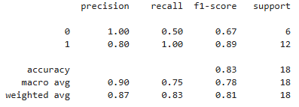
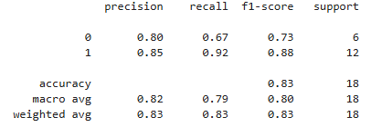
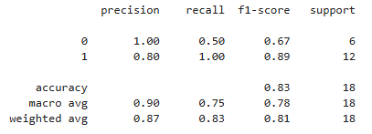
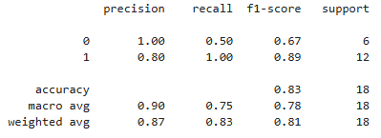
Executive Summary
Steps:
Data Collection (SpaceX REST API, WebScraping)
Data Wrangling
Exploratory Data Analysis (SQL)
Interactive Visual Analytics (Folium and Dash)
Predictive Analysis(Linear Regression, SVM, Tree, KNN)
Summary of all results
SSO, HEO, ES-L1 Orbits have a 100% success rate
Success Rate improves with time passing
VAFB-SLC was not used for heavier payload launches
Based on predictive analysis results, the Decision Tree model performs best on the reduced data set (18 samples)
Lin. Reg.
Dec. Tree
SVM
KNN

Slide 4
Introduction
Due to the high cost of replacing a booster SapceX can outperform competitors through reusing the boosters. The purpose of this project is to predict whether if Falcon 9 First Stage will land successfully.
We are trying to observe if there is a direct correlation between payload mass, orbit, launch site, flight number and mission success. Important to note that some of the failures have sometimes been planned by SpaceX due to various reasons.

Slide 5

Section 1

Slide 6
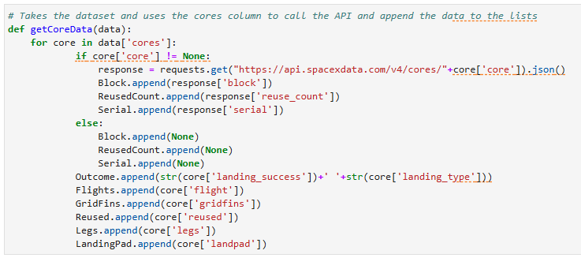
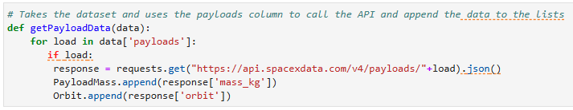
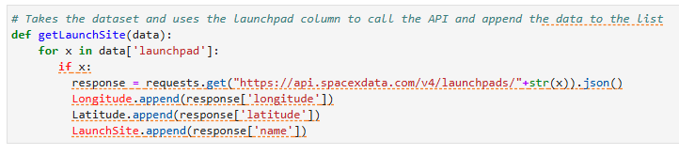
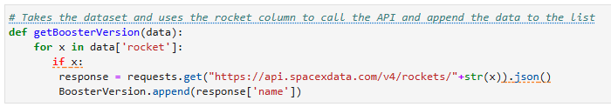
Data Collection
Data collected by using Space X Rest API:
Payload Information
LaunchSite Information
Core Information (Booster Version, serial, reused count, etc)

Slide 7
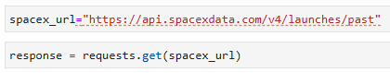
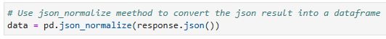
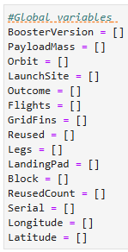
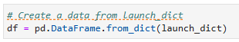

Notebook here!
Data Collection – SpaceX API
Define Methods to extract data from Response
Create Global Variables and populate using our defined methods
Data Wrangling (Filter to only include Falcon 9 boosters, remove unwanted columns, replace NaN values with average)
GET request from REST API
Normalize response JSON and convert to dataframe
Export to CSV for use in EDA

Slide 8
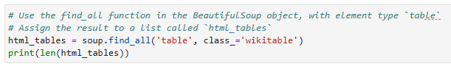
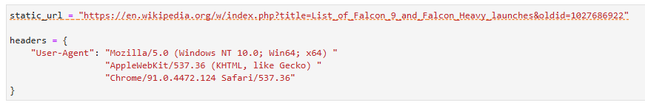
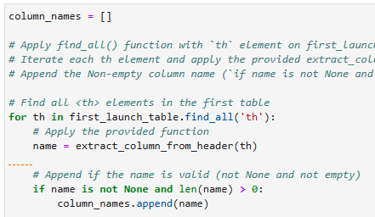
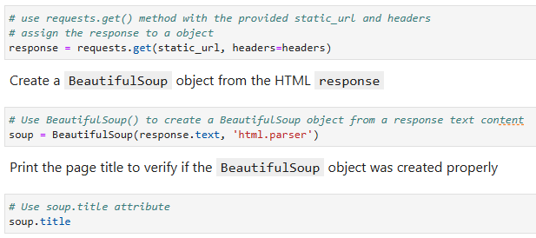
NoteBook here!
Data Collection - Scraping
Request the Falcon9 Launch Wiki page from its URL
Extract all column/variable names from the HTML table header
Create a data frame by parsing the launch HTML tables

Slide 9
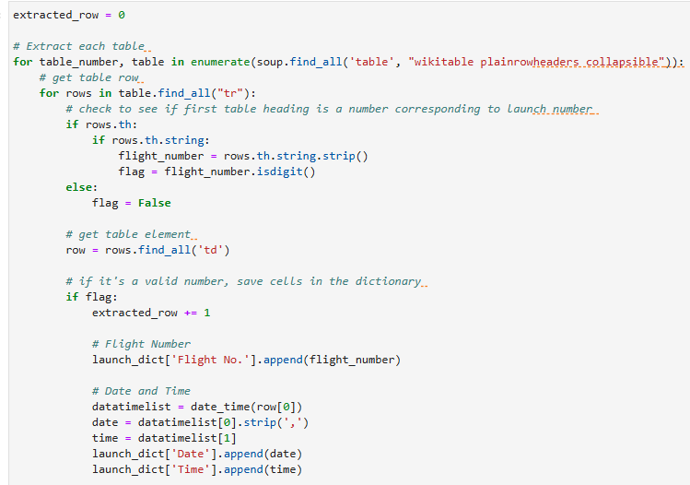
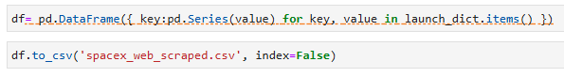
NoteBook here!
Data Collection - Scraping
Request the Falcon9 Launch Wiki page from its URL
Extract all column/variable names from the HTML table header
Create a data frame by parsing the launch HTML tables

Slide 10
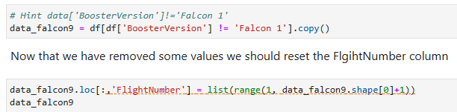

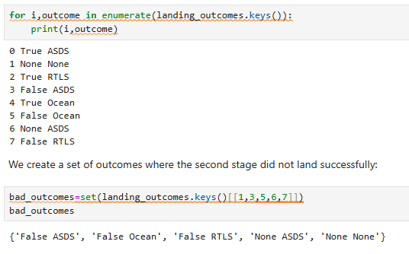
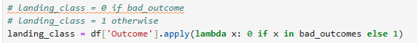
NoteBook Here!
Data Wrangling
The step consisted of these steps:
1. Filter the dataframe to only include Falcon 9 launches
2. Calculate average PayloadMass to replace NaN values within
Respective column
3. Consolidate Landing outcomes(as response Outcomes vary based on mission objectives):
4. Create a landing outcome label from Outcome column

Slide 11
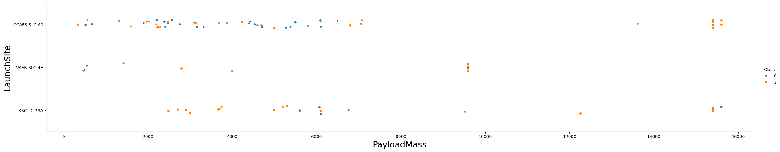
EDA with Data Visualization – LaunchSite/PayloadMass
Relevant in order to identify any corelaction between chosen site and payload.
We can identify that VAFB-SLC does not operate Payloads above 10000kg
Notebook Here!

Slide 12
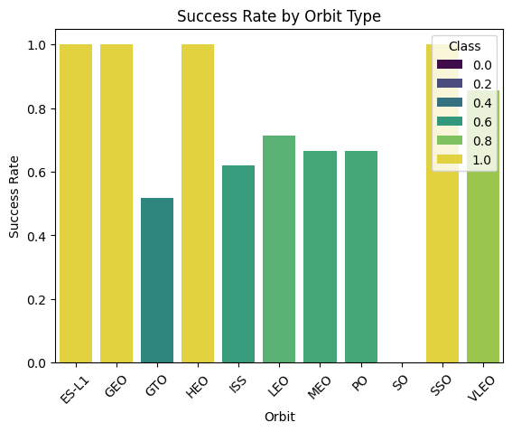
EDA with Data Visualization –SuccessRate/OrbitType
Relevant in order to identify if mission destination could affect success rate
We can identify that ES-l1, GEO, HEO and SSO orbits have a success rate of 100%
Notebook Here!

Slide 13
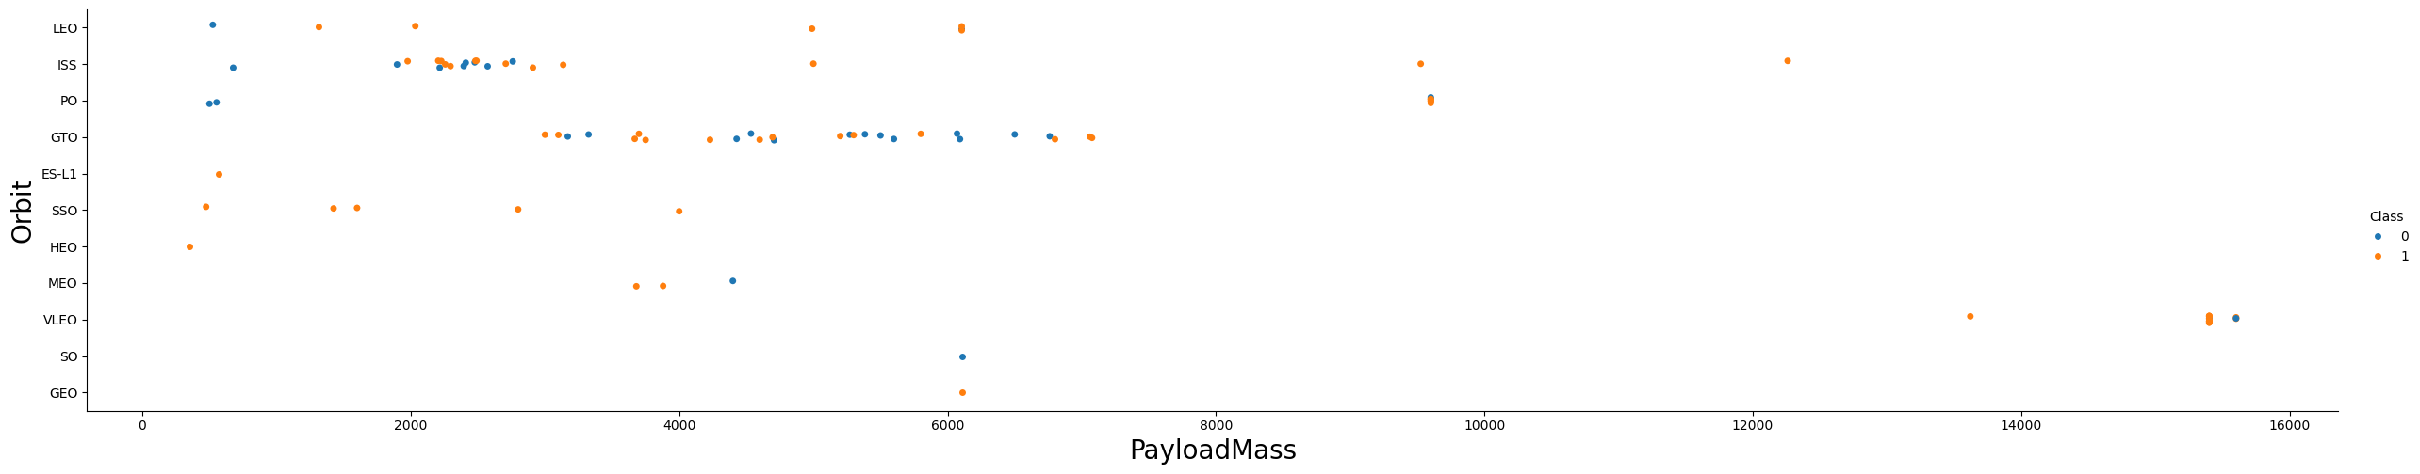
EDA with Data Visualization –OrbitType/Payload
With heavy payloads the successful landing or positive landing rate are more for Polar,LEO and ISS.
However, for GTO, it's difficult to distinguish between successful and unsuccessful landings as both outcomes are present.
Notebook Here!

Slide 14
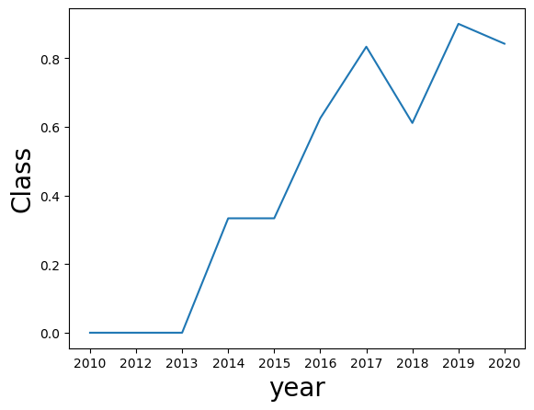
EDA with Data Visualization – Success/Year
Sucees Rate vs year is important in order to maintain trust and operability
We can see there is a positive trend as success rate has increased over 10 years
Notebook Here!

Slide 15
EDA with SQL
Notebook Here!
SQL Queries performed:
Display total mass launched by NASA (CRS)
1
Display average mass carried by an F9 V1.1 booster
2
List date of first successful ground landing pad outcome
3
List the names of the boosters which have success in drone ship and have payload mass greater than 4000 but less than 6000
4
List the total number of successful and failure mission outcomes
5
List all the booster_versions that have carried the maximum payload mass
6
List the records which will display the month names, failure landing_outcomes in drone ship ,booster versions, launch_site for the months in year 2015
7
Rank the count of landing outcomes (such as Failure (drone ship) or Success (ground pad)) between the date 2010-06-04 and 2017-03-20, in descending order.
8

Slide 16
Build an Interactive Map with Folium
Added:
NASA CRS
Launch Site Locations
Marker group for tracking launches with outcomes (green/red)
Mouse tracker for determining key distances to locations of interest from sites
Notebook Here!

Slide 17
Build a Dashboard with Plotly Dash
Site Drop down input component added with Pie Plot depicting success rates
Range Slider for Different Payload Ranges with Scatter Plot for Booster Type

Slide 18
Predictive Analysis (Classification)
4 Models were built and tested
Linear Regression
Support Vector Machine (SVM)
Decision Tree
K-Nearest Neighbours (KNN)
Used Test – Train function with the following parameters:
Set the parameter test_size to 0.2 and random_state to 2, producing 18 samples.
Cross Validation was set to 10 for each model

Slide 19

Section 2

Slide 20
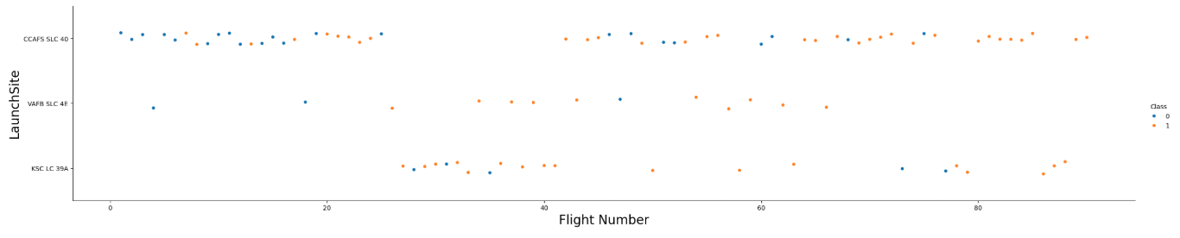
Flight Number vs. Launch Site
Show a scatter plot of Flight Number vs. Launch Site
Show the screenshot of the scatter plot with explanations

Slide 21
Payload vs. Launch Site
Show a scatter plot of Payload vs. Launch Site
Show the screenshot of the scatter plot with explanations

Slide 22
Success Rate vs. Orbit Type
Show a bar chart for the success rate of each orbit type
Show the screenshot of the scatter plot with explanations

Slide 23
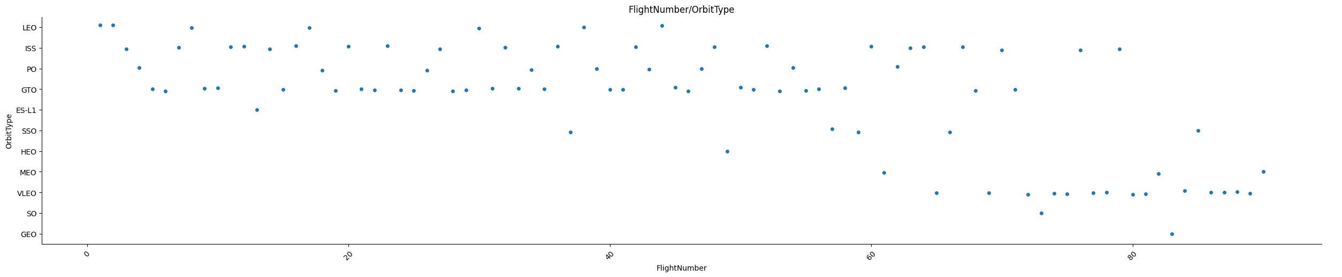
Flight Number vs. Orbit Type

Slide 24
Payload vs. Orbit Type
Show a scatter point of payload vs. orbit type
Show the screenshot of the scatter plot with explanations

Slide 25
Launch Success Yearly Trend
Show a line chart of yearly average success rate
Show the screenshot of the scatter plot with explanations

Slide 26
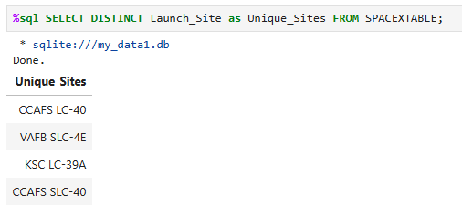
All Launch Site Names
There are 4 distinct Launch Sites as seen above

Slide 27
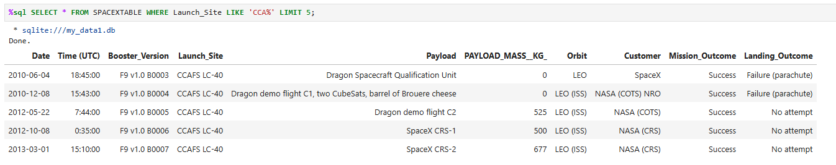
Launch Site Names Begin with 'CCA'
Find 5 records where launch sites begin with `CCA`
Present your query result with a short explanation here

Slide 28
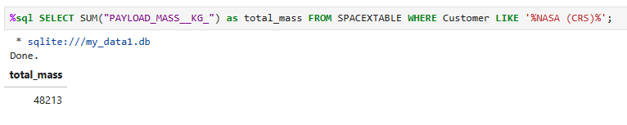
Total Payload Mass
Calculate the total payload carried by boosters from NASA
Present your query result with a short explanation here

Slide 29
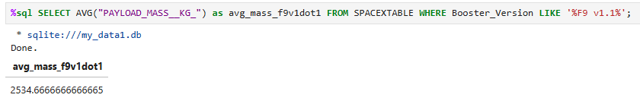
Average Payload Mass by F9 v1.1
Calculate the average payload mass carried by booster version F9 v1.1
Present your query result with a short explanation here

Slide 30
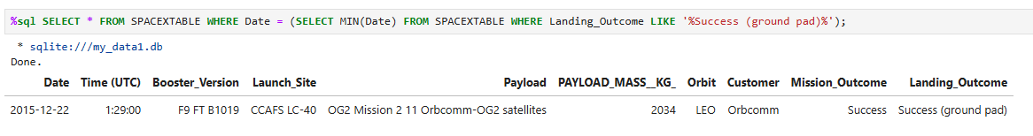
First Successful Ground Landing Date
Find the dates of the first successful landing outcome on ground pad
Present your query result with a short explanation here

Slide 31
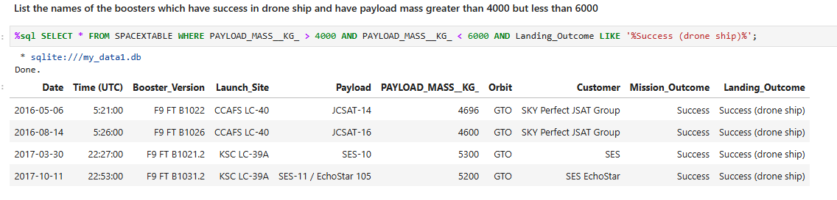
Successful Drone Ship Landing with Payload between 4000 and 6000
List the names of boosters which have successfully landed on drone ship and had payload mass greater than 4000 but less than 6000
Present your query result with a short explanation here

Slide 32
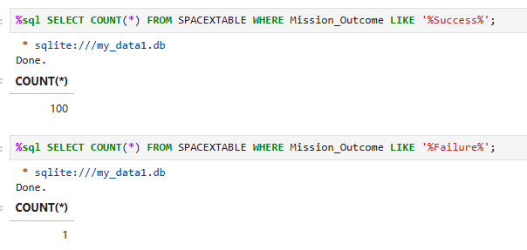
Total Number of Successful and Failure Mission Outcomes
Calculate the total number of successful and failure mission outcomes
Present your query result with a short explanation here

Slide 33
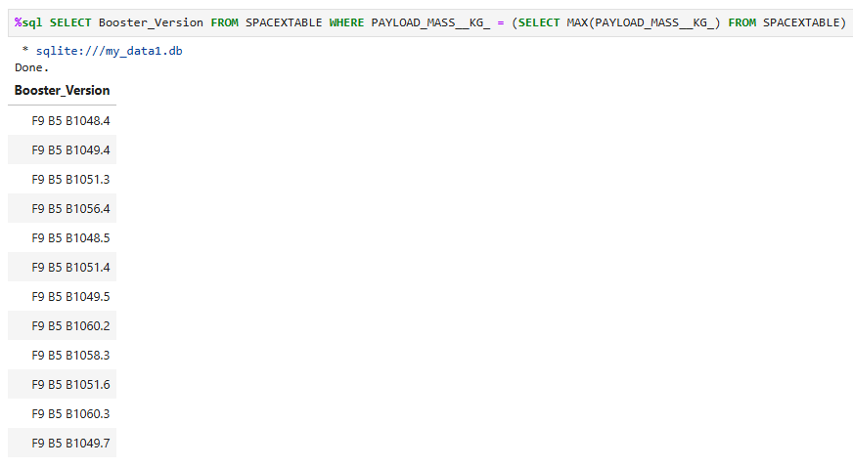
Boosters Carried Maximum Payload
List the names of the booster which have carried the maximum payload mass
Present your query result with a short explanation here

Slide 34
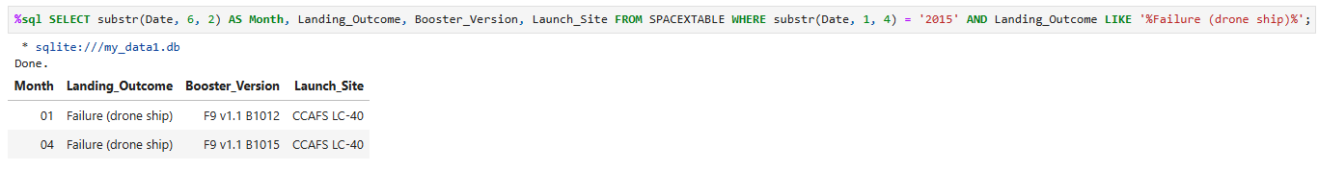
2015 Launch Records
List the failed landing_outcomes in drone ship, their booster versions, and launch site names for in year 2015
Present your query result with a short explanation here

Slide 35
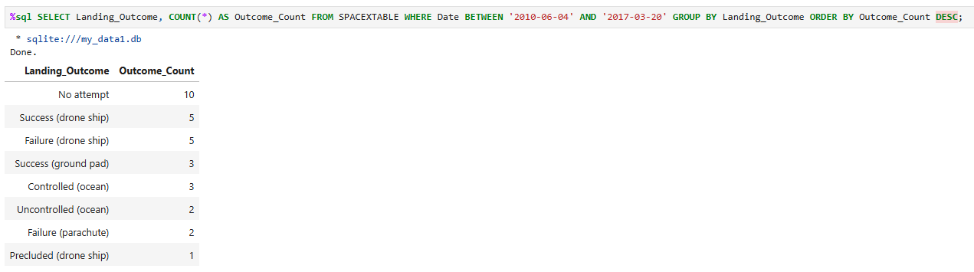
Rank Landing Outcomes Between 2010-06-04 and 2017-03-20
Rank the count of landing outcomes (such as Failure (drone ship) or Success (ground pad)) between the date 2010-06-04 and 2017-03-20, in descending order
Present your query result with a short explanation here

Slide 36

Section 3

Slide 37
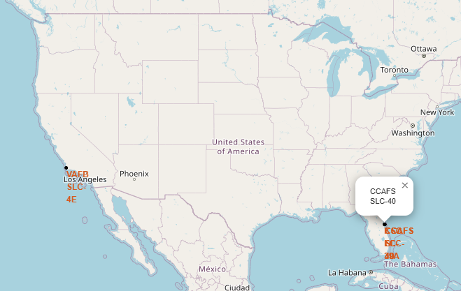
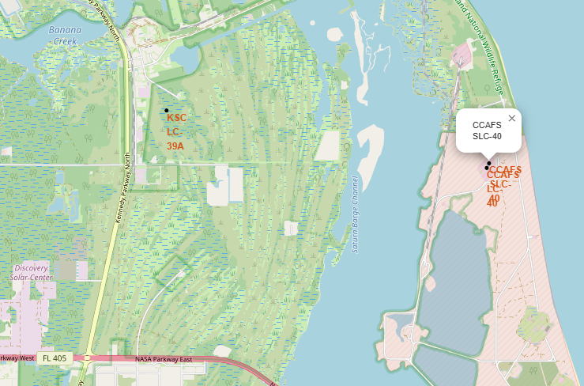
Folium – Launch Sites

Slide 38
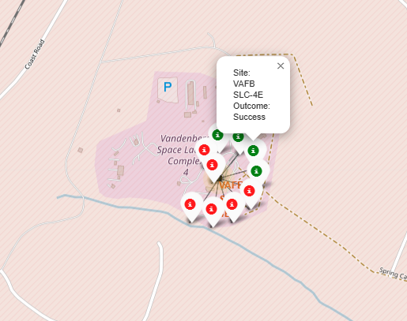
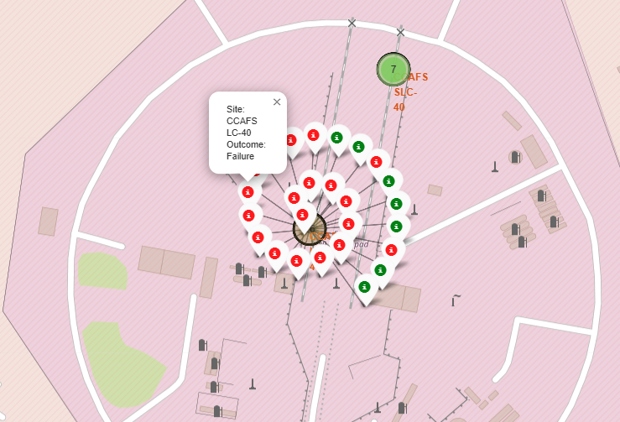
Folium – Color Labled launch outcomes
VAFB-SLC
CCAFS LC-40

Slide 39
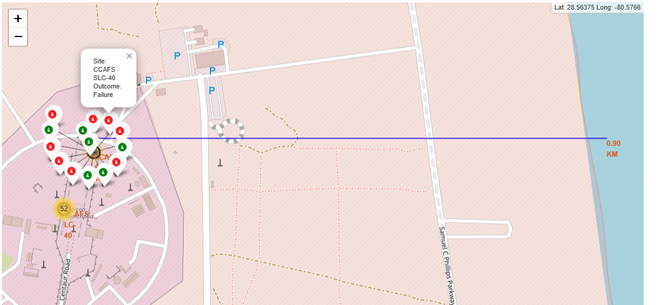
Folium – Marker between CCAFS-SLC to CoastLine

Slide 40

Section 4

Slide 41
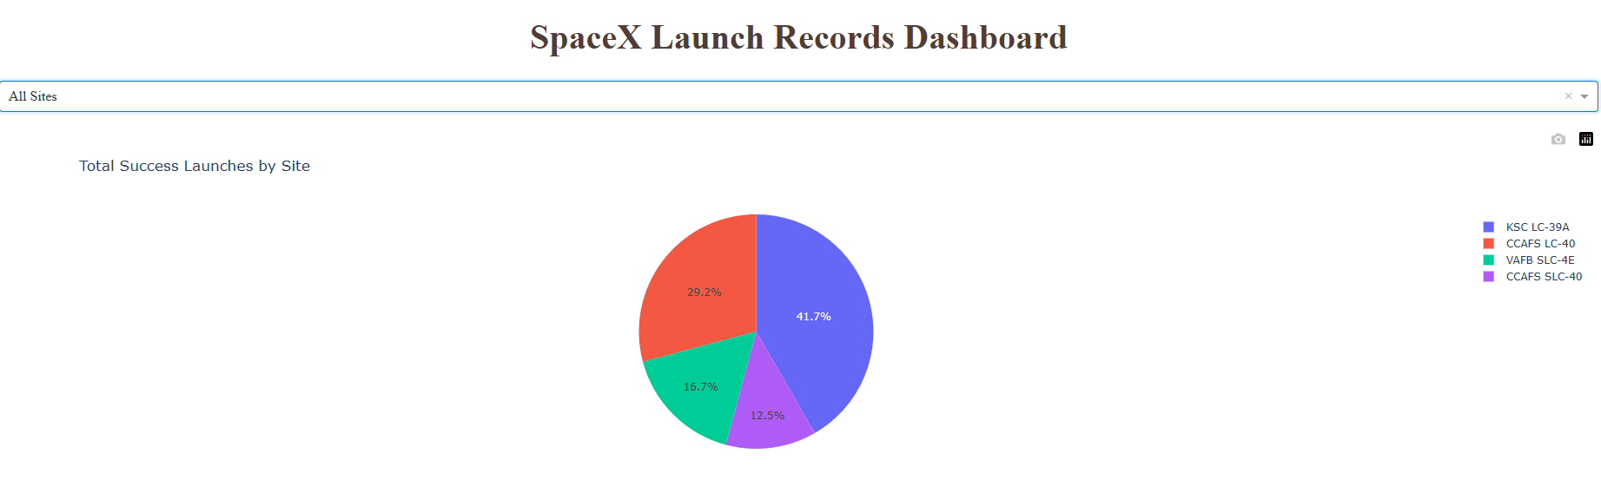
<Dashboard Screenshot 1>

Slide 42
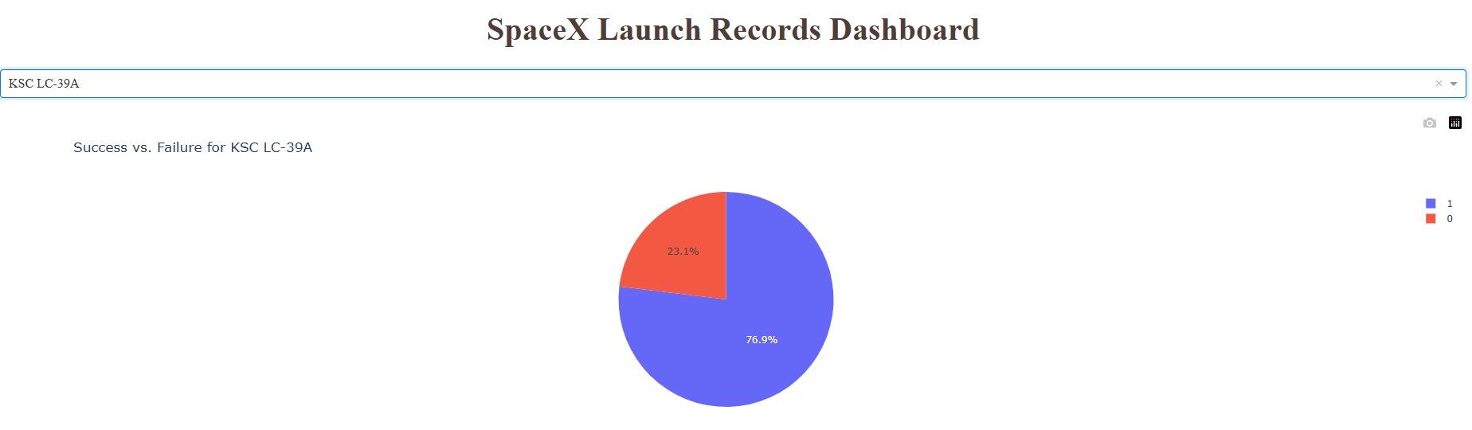
<Dashboard Screenshot 2>

Slide 43
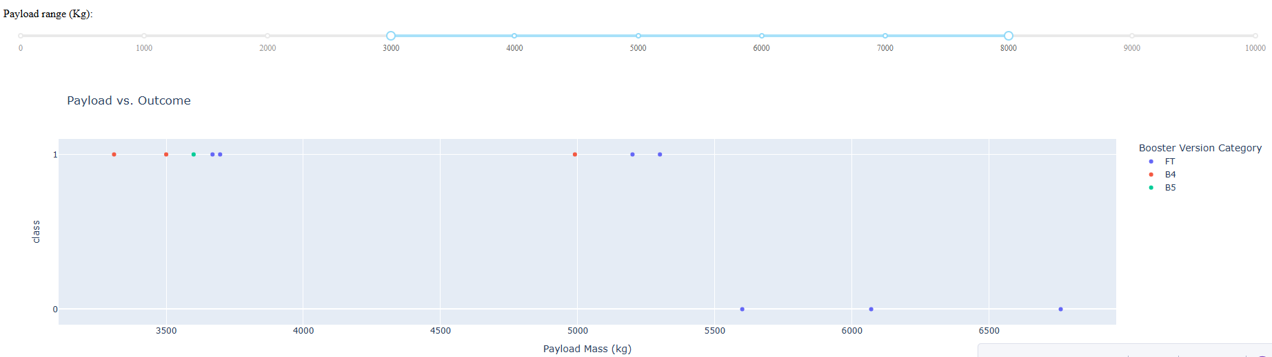
<Dashboard Screenshot 3>

Slide 44
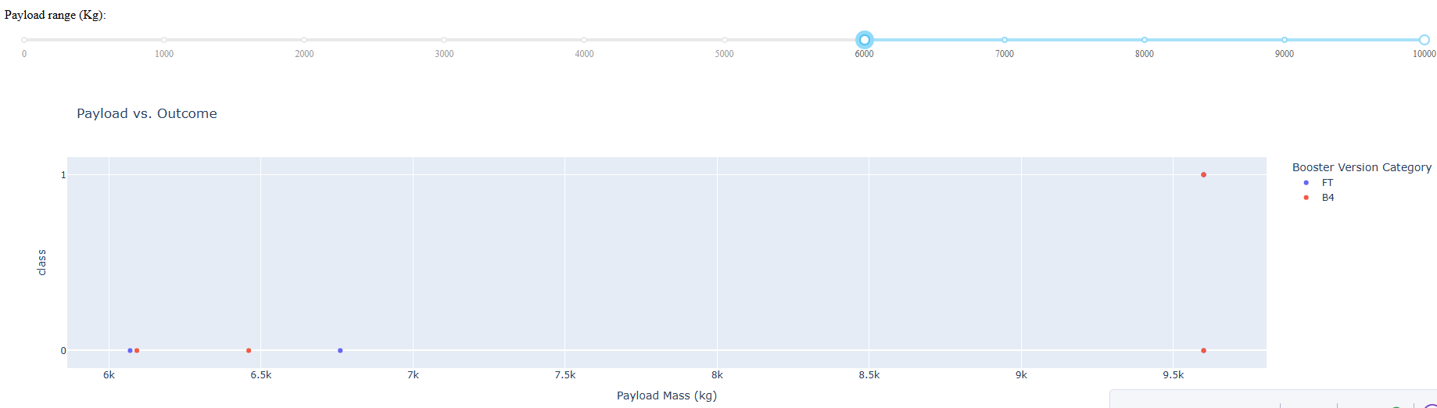
<Dashboard Screenshot 4>

Slide 45
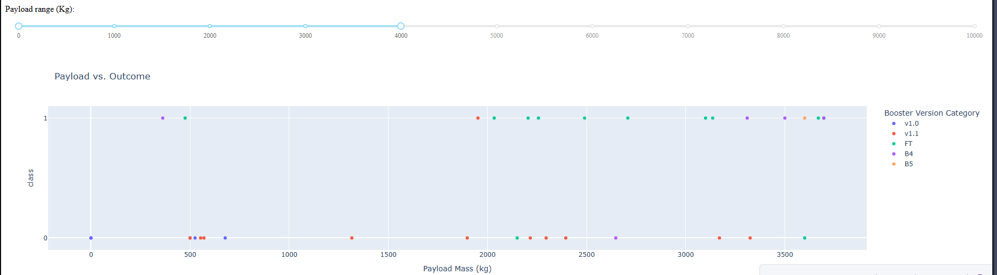
<Dashboard Screenshot 5>

Slide 46

Section 5

Slide 47
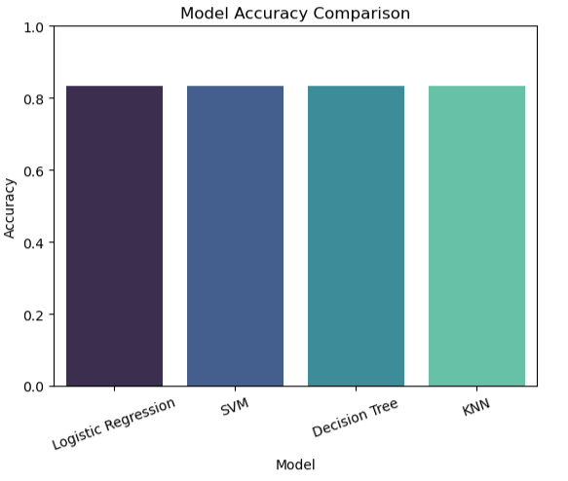
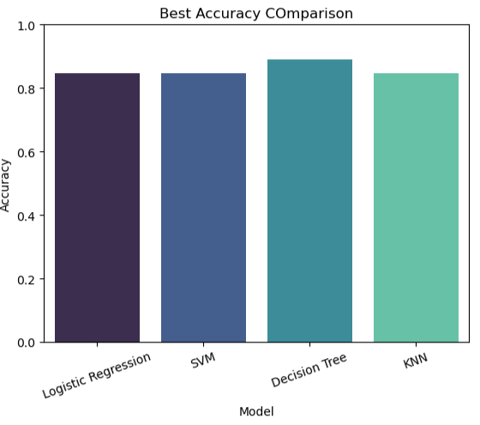
Classification Accuracy
Visualize the built model accuracy for all built classification models, in a bar chart
Find which model has the highest classification accuracy

Slide 48
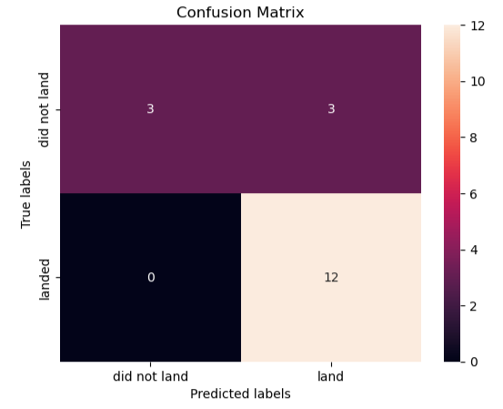

Confusion Matrix
There are 3 false positives, leading one to
Assume the Model presents a lower Recall.
Due to the Imbalanced Data, it would be best to
Proceed with the F-1Score: 0.67
Data Balance Overview: 66/33% 1-0

Slide 49
Conclusions
When using test set, all models produce the same accuracy, therefore the GridSearchCV best score parameter will be used, resulting in Decision Tree being the best choice. A larger test sample would produce a more conclusive result.
Multiple factors affect mission outcome such as Payload, Orbit type, and Site Location. There are additional factors not covered such as atmospheric conditions on launch day.
Under Heavier Payloads and Orbit type of Polar, LEO and ISS produce a positive landing rate while in general ES-L1, SSO, and HEO produce a higher success rate.

Slide 50
Appendix
Full Git hub: https://github.com/GenericParadox/IBM-Applied-Data-Science-Capstone

Slide 51


